Slide 1
YANG models for ACTN TE Performance Monitoring Telemetry and Network Autonomics
draft-lee-teas-actn-pm-telemetry-autonomics-00
Young Lee | Huawei
Dhruv Dhody
Satish K
Ricard Vilalta | CTTC
Daniel King | Lancaster University
Daniele Ceccarelli | Ericsson

Slide 2
Introduction
YANG data models that describe
Key Performance Indicator (KPI) telemetry
Network autonomics for TE-tunnels and ACTN VNs.
[I-D.xu-actn-perf-dynamic-service-control-03]
Performance Monitoring
Dynamic control in ACTN – creation, modification, optimization etc.
Monitor Network Traffic, Detects traffic imbalance, Initiate optimization!
Measure customer SLA, take dynamic action to make sure you meet them at all times
Scalability of Performance data
Support for
Performance telemetry data
Scaling Intent

Slide 3
Yang Model Relationships
TE Tunnel
Augments
TE KPI Telemetry
ACTN VN
Augments
ACTN TE Telemetry
TE KPI Telemetry model provides the TE tunnel level performance monitoring.
Augment the TE tunnel State with performance attributes
Use the notification subscription mechanism to subscribe to telemetry (YANG PUSH)
Scaling Intent configurations for auto scaling in/out based on the performance monitored attributes
ACTN TE KPI Telemetry model provides the VN level aggregated performance monitoring.
Augment the VN state as well as individual VN-member state with performance attributes.
Use notification subscription (YANG PUSH)
Scaling Intent configurations at the VN level to reach to the monitored performance KPI
Allow configuration of aggregation mechanism from the lower level telemetry details (max, mean etc.)
From VN-Member to VN
From per-domain tunnel to E2E VN-Member

Slide 4
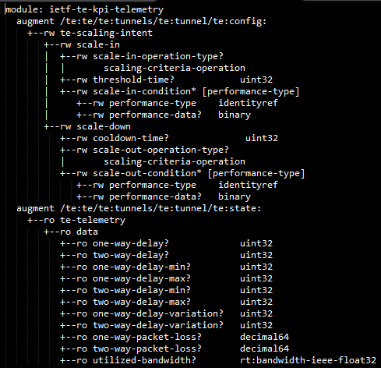
TE KPI Telemetry Yang Model
Telemetry Data
Delay, Delay-Variation, Packet-Loss, Bandwidth etc.
Scaling Intent
Scale-In
Scale-Out
Conditions

Slide 5
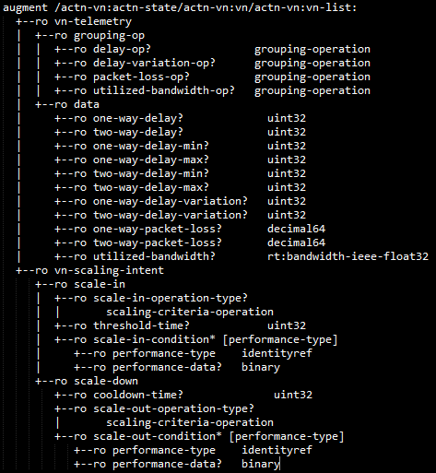
ACTN TE Telemetry Yang Model
VN Level
Telemetry Data
Delay, Delay-Variation, Packet-Loss, Bandwidth etc.
The aggregation grouping operation
Min, Max, Mean, Standard Deviation, Sum etc.
Scaling Intent
Scale-In
Scale-Out
Conditions

Slide 6
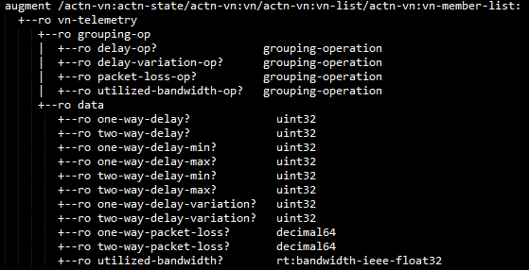
ACTN TE Telemetry Yang Model
VN-Member Level
Telemetry Data
Delay, Delay-Variation, Packet-Loss, Bandwidth etc.
The aggregation grouping operation
Min, Max, Mean, Standard Deviation, Sum etc.

Slide 7
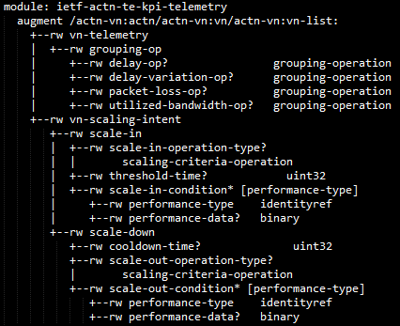
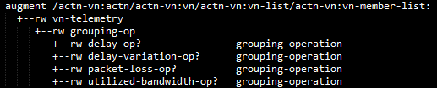
ACTN TE Telemetry Yang Model
VN-Level Configuration
Scaling
Scale-In, Scale-Out, Conditions
Grouping-Op
Min, Max, Mean, Standard Deviation, Sum etc.
VN-Member Level Configuration
Grouping-Op
Min, Max, Mean, Standard Deviation, Sum etc.

Slide 8
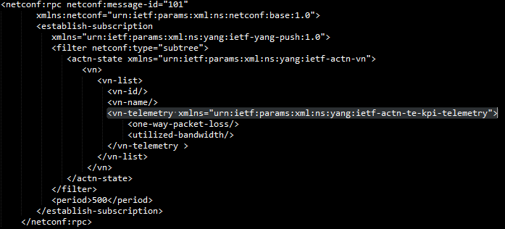
Telemetry Subscription
Via the Notification Subscription / Yang-Push mechanism
Subscribe notifications on a per client basis.
Specify sub-tree filters or xpath filters so that only interested contents will be sent.
Specify either periodic or on-demand notifications.

Slide 9
Interactions
CNC
CNC configure the grouping-operation for delay and bandwidth utilization.
CNC subscribes to the VN level telemetry for delay and bandwidth utilization on a periodic basis
MDSC receives the VN telemetry data
VN-1
VN Bandwidth Utilization as X (Minimum across VN-Members)
VN Delay as Y (Maximum across VN-Members)
MDSC
a. MDSC subscribe for the tunnel telemetry for delay and bandwidth utilization on a periodic basis
b. PNC provides the tunnel telemetry data for the tunnels
PNC
PNC
Recursively applied at the device level

Slide 10
Next Steps
Is this Yang Model useful?
Should we have telemetry and scaling in the same model?
Continue to enhance the model…
Comments welcome!

Slide 11


